Slide 1
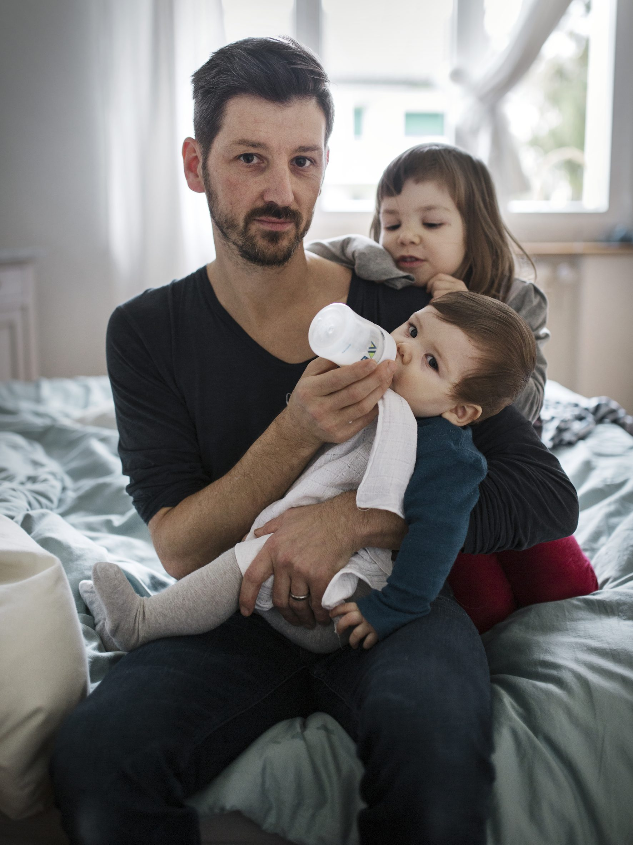
To share fair.
1. Why?
2. How?
3. Who?

Slide 2
UN Sustainable Development Goal 5
«To ensure women’s full and effective participation and equal opportunities for leadership at all levels of decision-making in political, economic and public life.»
1 2 3

Slide 3
Missing Link
«To ensure men’s full and effective participation and equal opportunities for leadership at all levels of decision-making in family life.»
1 2 3

Slide 4
1 2 3
Salary: work & responsibility
Family: work &
responsibility
Theunert (2012)

Slide 5
1 2 3
Men
Salary: work & responsibility
Family: work &
responsibility
Women
Theunert (2012)

Slide 6
1 2 3
1
Men
Salary: work & responsibility
Family: work &
responsibility
Women
3
Theunert (2012)

Slide 7
1 2 3
2
1
Men
Salary: work & responsibility
Family: work &
responsibility
Women
3
4
Theunert (2012)

Slide 8
Because it‘s just
Because it‘s a need
Because it‘s profitable
1 Why?

Slide 9
Because it‘s just
Because it‘s a need
Because it‘s profitable
1 Why?

Slide 10
1 2 3
How do working-time and social/family commitments fit? (Source: Fifth European Working Condition Survey / Eurofound)

Slide 11
Because it‘s just
Because it‘s a need
Because it‘s profitable
1 Why?

Slide 13
By valuing what is already done
By showing individual benefits
By taking multilevel action
By creating adequate conditions
2 How?

Slide 14
Relationality and
Responsibility
as Attitude and
Competency
1 2 3

Slide 15
Relationality and
Responsibility
as Attitude and
Competency
Taking Care of the Household
1 2 3

Slide 16
Relationality and
Responsibility
as Attitude and
Competency
Taking Care of the Household
1 2 3
Caring about/for Children (Fatherhood)

Slide 17
Relationality and
Responsibility
as Attitude and
Competency
Taking Care of the Household
1 2 3
Caring about/for Children (Fatherhood)
Caring about/for Family (Partners, Parents, Relatives)

Slide 18
Relationality and
Responsibility
as Attitude and
Competency
Taking Care of the Household
1 2 3
Caring about/for Children (Fatherhood)
Caring about/for Family (Partners, Parents, Relatives)
Caring about/for Others (Friends, Neighbors etc.)

Slide 19
Relationality and
Responsibility
as Attitude and
Competency
Taking Care of the Household
1 2 3
Caring about/for Children (Fatherhood)
Caring about/for Family (Partners, Parents, Relatives)
Caring about/for Others (Friends, Neighbors etc.)
Caring for the Community / Volunteer Work

Slide 20
Relationality and
Responsibility
as Attitude and
Competency
Taking Care of the Household
1 2 3
Caring about/for Children (Fatherhood)
Caring about/for Family (Partners, Parents, Relatives)
Caring about/for Others (Friends, Neighbors etc.)
Caring for the Community / Volunteer Work
Caring about Nature/ Taking Care of the Environment

Slide 21
Relationality and
Responsibility
as Attitude and
Competency
Taking Care of the Household
1 2 3
Caring about/for Children (Fatherhood)
Caring about/for Family (Partners, Parents, Relatives)
Caring about/for Others (Friends, Neighbors etc.)
Self-Care /
Men‘s Health
Caring for the Community / Volunteer Work
Caring about Nature/ Taking Care of the Environment

Slide 22
Relationality and
Responsibility
as Attitude and
Competency
Taking Care of the Household
1 2 3
Caring about/for Children (Fatherhood)
Caring about/for Family (Partners, Parents, Relatives)
Professional Contributions
Caring about/for Others (Friends, Neighbors etc.)
Self-Care /
Men‘s Health
Caring for the Community / Volunteer Work
Caring about Nature/ Taking Care of the Environment

Slide 23
Relationality and
Responsibility
as Attitude and
Competency
Taking Care of the Household
1 2 3
Caring about/for Children (Fatherhood)
Material Aspects of Caregiving/ Earning Money
Caring about/for Family (Partners, Parents, Relatives)
Professional Contributions
Caring about/for Others (Friends, Neighbors etc.)
Self-Care /
Men‘s Health
Caring for the Community / Volunteer Work
Caring about Nature/ Taking Care of the Environment

Slide 24
By valuing what is already done
By showing individual benefits
By taking multilevel action
By creating adequate conditions
2 How?

Slide 25
Download:
http://sowf.men-care.org

Slide 26
By valuing what is already done
By showing individual benefits
By taking multilevel action
By creating adequate conditions
2 How?

Slide 27

2 How?
http://www.mencare.swiss (English version available)

Slide 28
Information
Values/Norms
Structural Change
Societal
Institutional
Invididual
Information
Values/Norms
Behavioural Change

Slide 29
Information
Societal
Institutional
Invididual
Information
Values/Norms
Behavioural Change

Slide 30
Information
Values/Norms
Structural Change
Societal
Institutional
Invididual
Information
Values/Norms
Behavioural Change

Slide 31
Information
Values/Norms
Structural Change
Societal
Institutional
Invididual
Information
Values/Norms
Behavioural Change

Slide 32
Information
Values/Norms
Structural Change
Societal
Institutional
Invididual
Information
Values/Norms
Behavioural Change

Slide 33
Information
Values/Norms
Structural Change
Societal
Institutional
Invididual
Information
Values/Norms
Behavioural Change

Slide 34
By valuing what is already done
By showing individual benefits
By taking multilevel action
By creating adequate conditions
2 How?

Slide 35
1 2 3
Advocating for gender justice
Terrain of progressive
men and masculinities
Interceding
men’s vulnerabilities and concerns
Supporting women’s rights

Slide 36
1 2 3
Equality for all gender
Relational gender equality policies
Equality for Men
Equality for Women

Slide 37
By valuing what is already done
By showing individual benefits
By taking multilevel action
By creating adequate conditions
2 How?

Slide 38
The progressive alliance
= everyone accepting, promoting and holding accountable for «share fair»
3 Who?

Slide 39
1 2 3
Employment
Reconciliation
Family
Proper Time

