Slide 1
Theories and Changes: Men’s Caregiving and European Development
ICMEO – 3rd International Conference on Men and Equal Opportunities
Keynote October 17, 2016
Øystein Gullvåg Holter
Centre for Gender Research
University of Oslo

Slide 2
Disposition
1 Development of caregiving masculinity
2 Importance for gender equality and social development
3 Potentials for European change
Some European projects and networks (where I have participated)
The Role of Men
in Gender Equality
GEQ
IMAGES

Slide 3
Development of men’s caregiving
Three reasons why men become active as caregivers
1 Gender equality orientation
2 Family and care orientation
3 The situation (includes the wife/partner’s situation, the need for male involvement, the man’s ability and situation)
Active caregivers (fathers of small children) is a very heterogenous group (Work Changes Gender EU study)
Recent studies indicate that gender equality orientation becomes more important
Development from «helper» role to «responsible» role

Slide 4
Caregiving situations
In families and private life, men typically become more caregiving if...
There is a need (child, elderly, ill)
It is supported (or demanded) by women
It is supported (or not fully hindered) by working life
There is a perceived benefit (or at least no large detriment) for men themselves
The greater the cultural and political support for men’s caregiving, the larger the chance that many different types of men contribute
Stereotypes and social sanctions still hit men who go «outside» the traditional male breadwinner role
Importance of stereotypes (e.g. «girls are caregiving, boys are not») and implicit bias
Example Stian Overaa 2013 phd – anthropological field work shows caregiving among boys
Empirical reality is not in line with adult preconceptions

Slide 5
Caregiving as freedom of choice
Male caregiving offers today’s men the possibility to choose options not available to men before
Policy makers can help make this freedom of choice realistic for boys and men
Increasing support for gender equality
Even in relatively «gender-traditional» Poland:
three of four men agree that gender equality is important (2015 survey)
Only a minority think that gender equality is a threat to the Polish family

Slide 6
What’s in it for men?
Is gender equality a plus or a minus for men? What are the well-being and health effects?
New studies:
Gender equality and balanced caregiving has a clear positive effect on quality of life and health, not only for women, but also for men
Poland 2015, Norway 2007 surveys show that growing up in a gender-equal family approximately halves the chance of violence and physical punishment in childhood
Men and women report the same pattern – gender equality reduces the chance of family conflict and violence
In a study of 82 regions (European countries and US states), gender equality has a positive health effect, independently of income level and income distribution
Rates of depression and violence are generally higher in the less gender-equal regions for men as well as women.
Low gender equality regions are also low quality of life regions, and also often high violence rate regions (esp in the US).
The less gender-equal the country, the greater is men’s rate of suicide, compared to women’s rate of suicide.
This runs fully contrary to the idea that men «suffer» from gender equality

Slide 7
New research examples

Slide 8
Example result
Theoretical model

Slide 9
The strategical importance of caregiving
A strong connection – between men’s share of care, and how a country ranks according to gender equality indexes – is found in recent studies
Diagram – at left – two existing GE indexes, mainly focused on women’s public life positions
At right – men’s share of unpaid work in the household
These data have not been combined before
The connection is so strong that it seems timely to include measures of men’s share of care, in gender equality indexes

Slide 10
Gender equality and the rights of the children
Conflicts, violence and lack of care in childhood increase the chance of negative patterns later in life
Violence, especially, is a clear indicator
(Norway 2007 data)

Slide 11
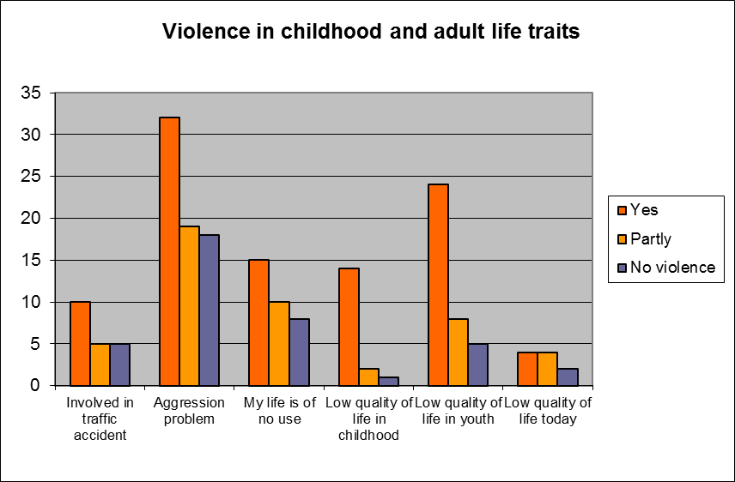
Norway 2007 survey results (N=2718 men and women)

Slide 12
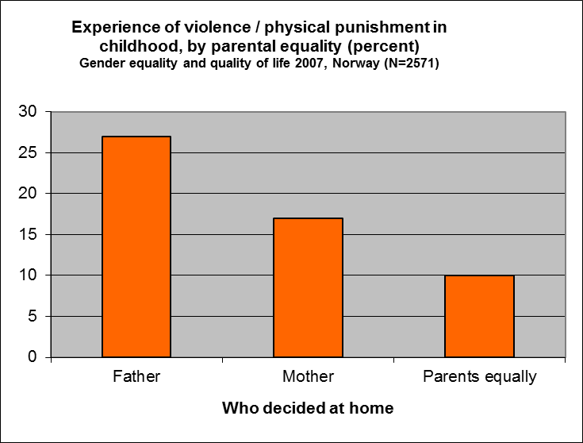
Poland 2015 survey – similar pattern Men and women report the same Conclusion: Gender equality at home is of key importance for children’s well being

Slide 13
Potentials and barriers
Barriers and stereotypes still strong
Paternity leave evidence:
Dads use birth leave mainly when they are compensated for it, even if some do it anyway
When the compensated leave is extended, most take up longer leave; when it is shortened, the rate goes down
- (Recent Norway evidence)

Slide 14
Freedom – a main issue
All boys and men should feel free to express their individual choices, including their ability to cross traditional social and cultural gender borders, without being informally or formally punished for it, without stigmatization or harrasment.
Men should be free to combine active caregiving for children, elderly and others, with their jobs and careers, with no detriment or devaluation of their roles in working life.

Slide 15
«Karl was extremely tired after the daddy’s quota period»
Reported by a researcher, Norway 2013
Kristine W Smeby, in Brandth and Kvande 2013:158
Research shows varied uptake and use of the father quota
There is now a list of «what to do» and «not to do» – e g, fathers need to be encouraged to take leave on their own, having responsibility, not just a helper role
Beneficial macro statistics show overall trends – but some men don’t profit from caring, or gender equality
The diversity of men’s responses to gender equality shows up in the different uses of the paternity leave

Slide 16
Political importance
Care as alternative to violence
Balanced caregiving reduces the chance of violence
Now very clear evidence regarding children as well as adult couples
It does not «always» work this way – but is a general rule
Radicalization of young men – lack of care is part of the background
Caregiving fathers – not typical of terrorists’ background
Example, A B Breivik case – absent father, traumatized childhood

Slide 17
Economic importance
Realize the dual career ambition, improve women’s labor market position
Men who are active caregivers are also often innovators in the workplace, according to Nordic studies
A focus on caregiving men is a way to improve the work organization
Develop the European labor market as a platform for social development
A gender-balanced, more truly meritocratic information-based economy

Slide 18
A first step ahead
Knowledge needed – a key to European development in this field
Apply the new European gender equality survey proposal
Use the «Blueprint» European questionnaire, made on the basis of the Norway 2007 and Poland 2015 surveys
An in-depth, detail survey which also has a flexible approach
We need to know more of the actual gender equality and caregiving variation in Europe

Slide 19
Conclusions
The development of caregiving and gender-equal forms of masculinity is central for European development
The EU should invest in research and development
Caregiving masculinity and gender equal men are important parts of a more democratic and social Europe, and not a kind of luxury that should «wait» until the crises are over
Combining caregiving, family and gender equality, it is possible to create a common European agenda

Slide 20
References
Caregiving among boys:
Overå, Stian 2013: KJØNN – BARNDOM – SKOLELIV: Faglige og sosiale inkluderings- og ekskluderingsprosesser i barneskolen. PhD avhandling, Sosialantropologisk institutt, Universitetet i Oslo
Norway 2007 gender equality survey:
Holter, Øystein Gullvåg; Svare, Helge & Egeland, Cathrine 2009: Gender Equality and Quality of Life - A Nordic Perspective. Nordic Gender Institute (NIKK) and The Work Research Institute (WRI), Oslo
Poland 2015 survey, and European blueprint survey:
In print
Health and well-being:
Holter, Øystein Gullvåg 2014: "What's in it for Men?": Old Question, New Data. Men and Masculinities 17(5), 515-548
Caregiving and social innovation:
Holter, Øystein Gullvåg (ed) 2007: Män i rörelse. Jämställdhet, förändring och social innovation i Norden. [Men in motion. Gender equality, change and social innovation in the Nordic region]. Gidlunds forlag, Hedemora, Sweden
Paternity leave:
Brandth, Kvande; Kvande, Elin 2014: Fedrekvoten og den farsvennlige velferdsstaten [The father quota and the father-friendly welfare state], Universitetsforlaget, Oslo
Violence:
Holter, Øystein Gullvåg 2013: Masculinities, Gender Equality and Violence. Masculinities and Social Change (MCS) 2, 1, 51-81. http://www.hipatiapress.info/hpjournals/index.php/mcs/article/view/498/pdf
Trauma and terrorism:
Seierstad, Åsne 2015: One of Us: The Story of Anders Breivik and the Massacre in Norway. Farrar, Straus and Giroux
Holter, Øystein Gullvåg 2004: A Theory of Gendercide. In Jones, Adam, ed.: Gendercide and genocide. Vanderbilt University Press, Norman

