Slide 1
The Revolution in Care Work:
Where Fathers Are and Where We Can Help them Be …
Gary Barker, International Director

Slide 2

Why a Global Report on Fathers?
4 out of 5 are or will be biological fathers
Huge inequalities still remain
UN processes and documents continue to remain pessimistic about men
Involved fatherhood brings benefits for men, women, children and societies.

Slide 3
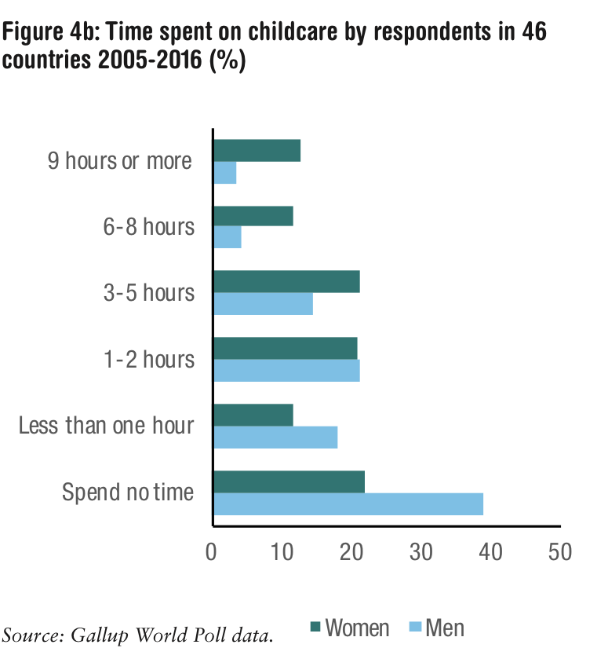
Let’s Talk about the Inequalities: Time Use, Women’s Income

Slide 4

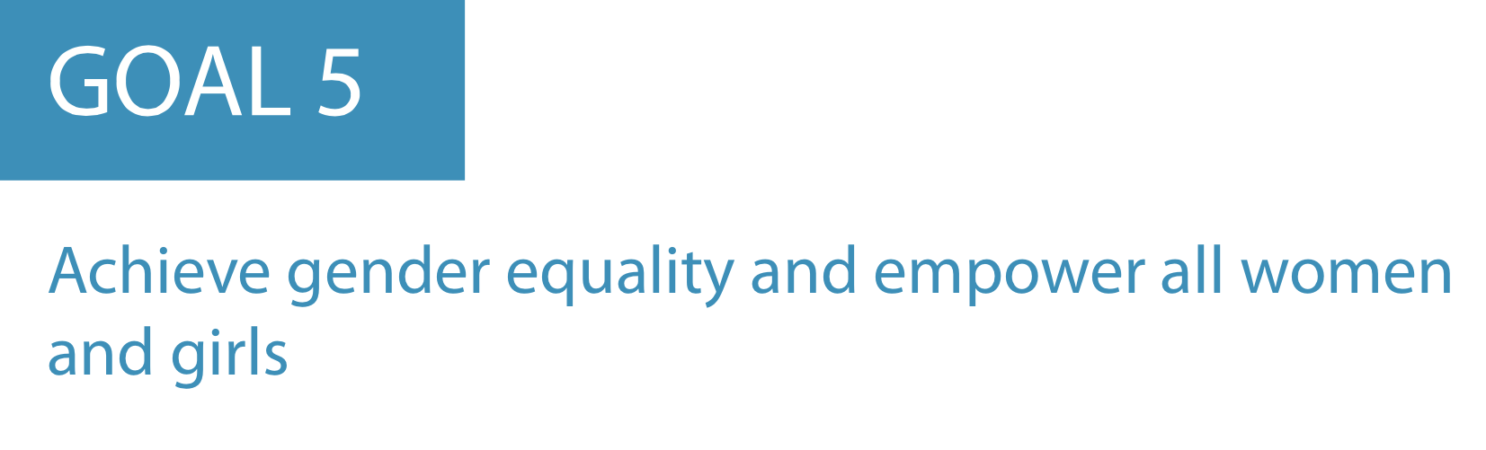
Why Are the SDGs So Timid on Unpaid Care Work?

Slide 5
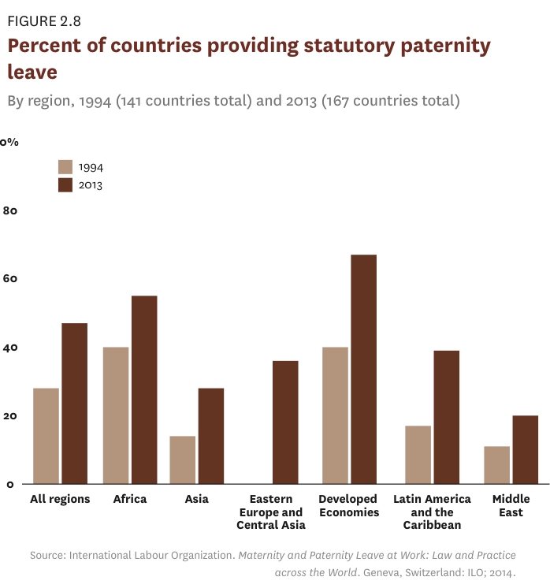
More Countries Offering Paternity Leave But …

Slide 6
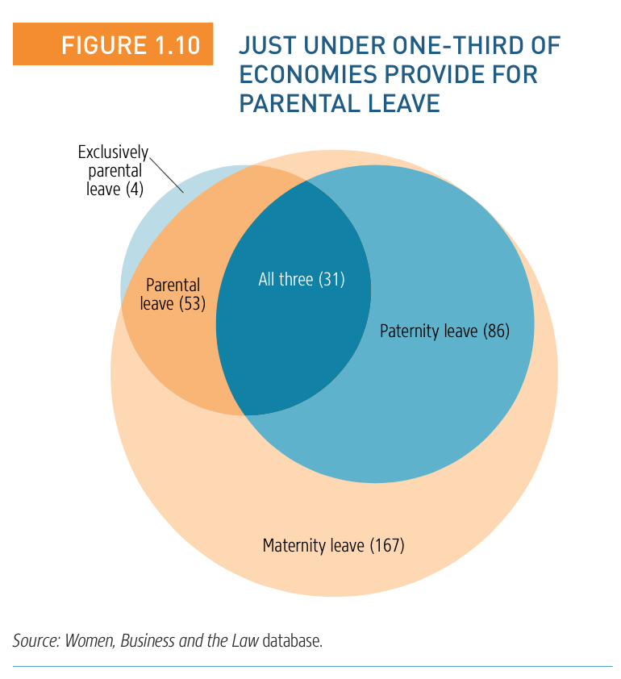
Only a Third of Countries Globally Support Equal Caregiving

Slide 7
Going nowhere fast: Men’s share of contraceptive use globally
2005
2013

Slide 8
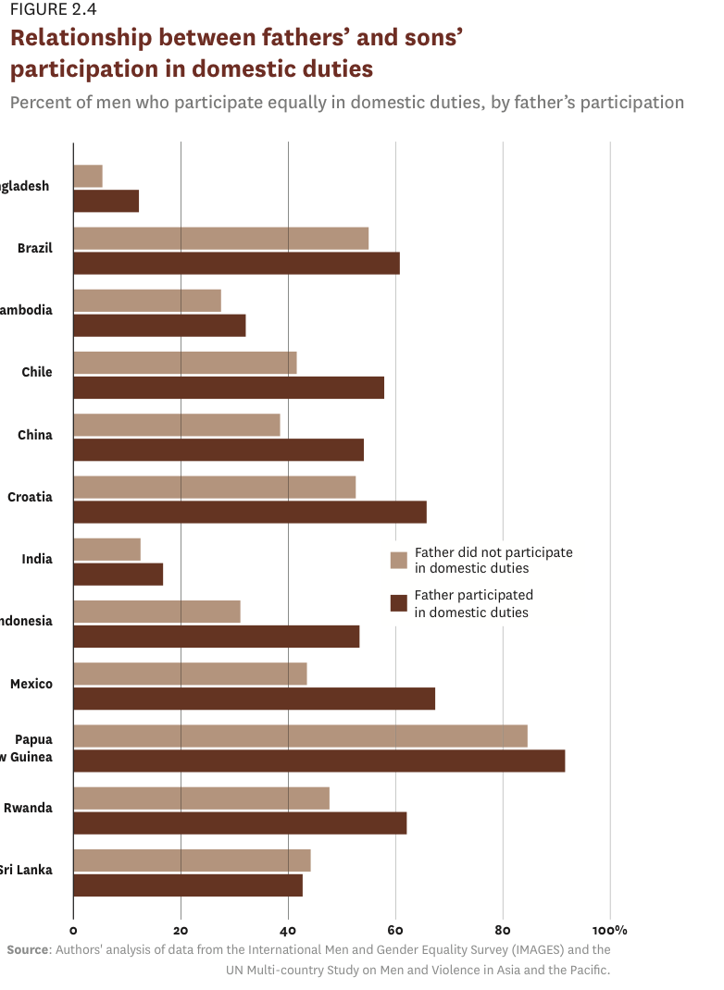
Can We Change the Norms? Results from IMAGES Find that Caregiving Generates Caregiving

Slide 9
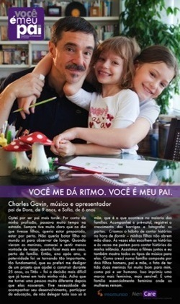
Which Men Do the Caregiving?
Those who:
Cared for younger siblings as child
Have father who did care work
Were not exposed to violence
Work fewer hours
Took paternity leave
Have a partner (the child’s mother) who also works outside the home
Notes:
GARY

Slide 10
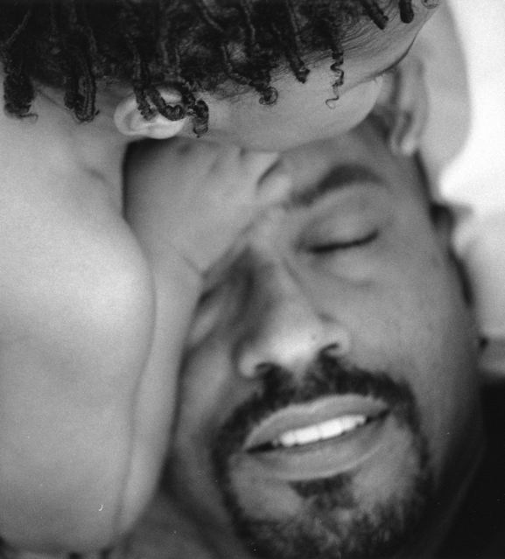
“Men Who Care” Study
Life history interviews 83 men in 5 countries (selected for their primary caregiving roles and professional caregiving roles) – Promundo and ICRW
Men doing caregiving:
But lack references for men doing care work
Feel confused about their new roles
Frequent depression when only did caregiving
But find that caregiving roles served as pathway to new ways of expressing connection, emotions – in other words of being more human
For the “men who care” gender equitable attitudes were not a pathway to caregiving – caregiving was a pathway to gender equitable attitudes

Slide 11
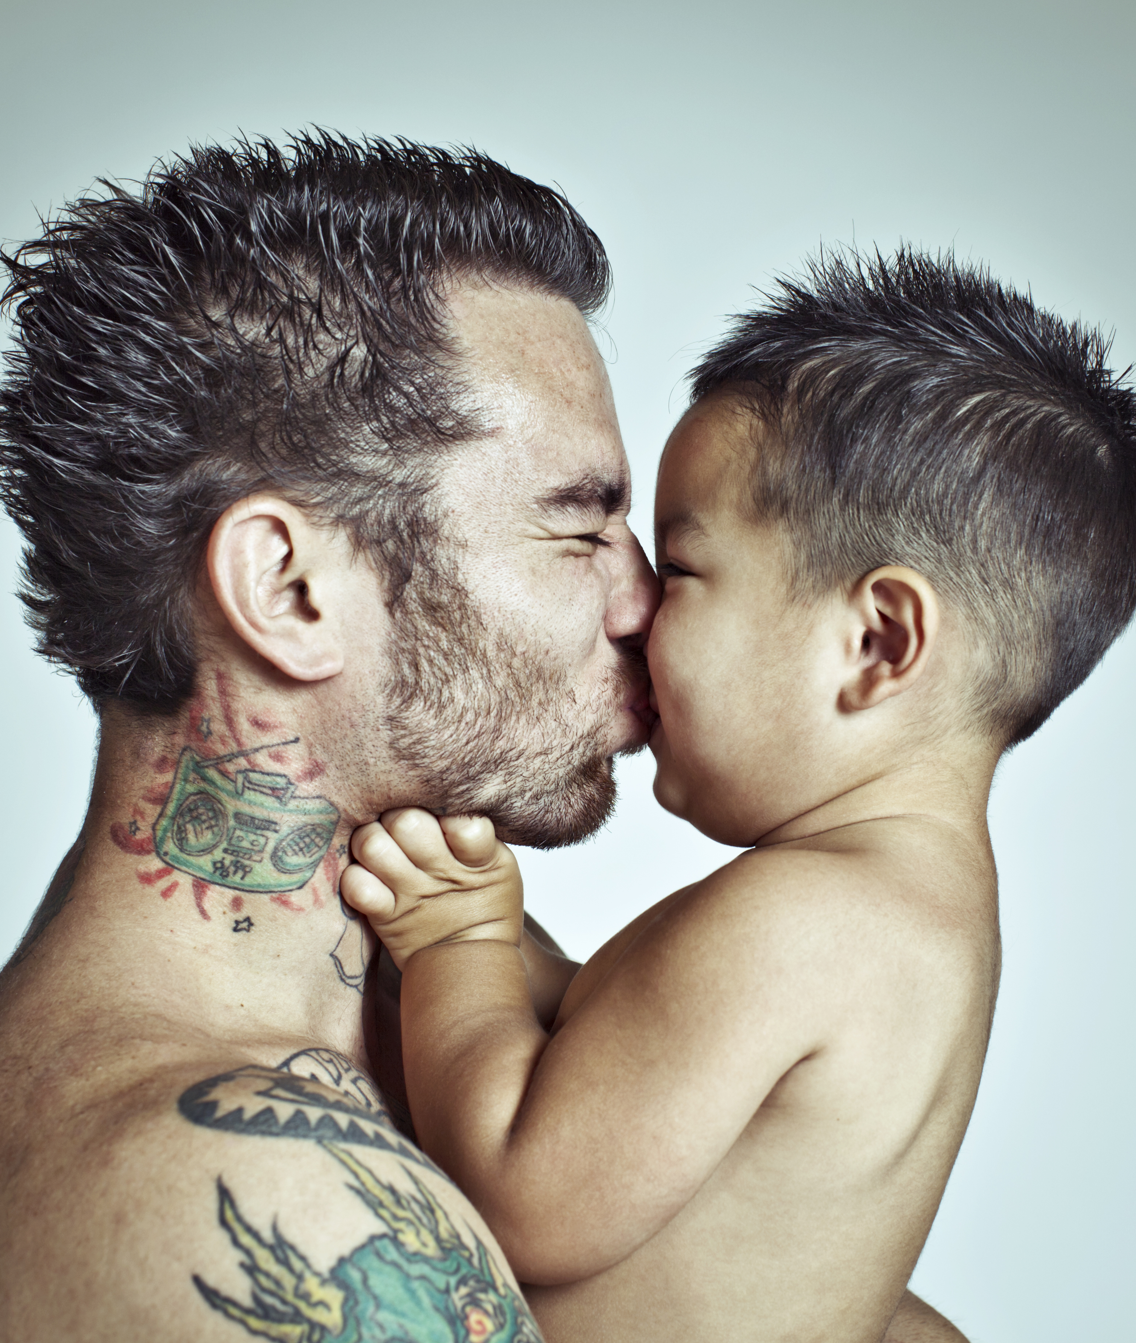
Mind the Gap
Key Findings: State of America’s Fathers
8 to 10 million
is the estimate of the total number of nonresident fathers in the U.S., majority low income
2.7 million
children have an incarcerated parent; 10% of children have a parent who has been in prison

Slide 12

Key Entry Point in Global South: The Health Sector
Collaboration with public health sector in Brazil; with community-based NGO in case of Rwanda
Brazil: Collaboration with Men’s Health Sector/MOH to create men’s pre-natal health visit; focus on health worker training
Rwanda: community recruitment of pregnant couples; 16-week parent training module with activities on SRHR, GBV, MNCH, caregiving
Notes:
GARY

Slide 13
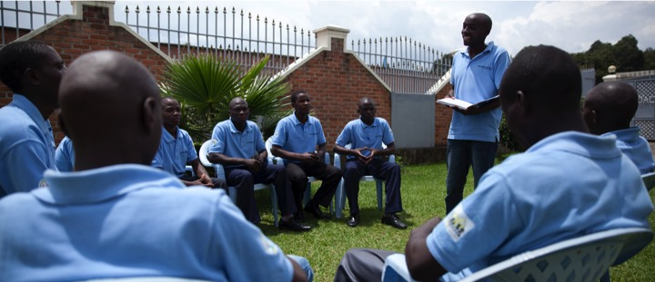
Randomized Control Trial in Rwanda: More than 1,700 fathers and their partners participated in father training: IPV and VAC decreased by half; men’s caregiving increased. (Source: Promundo)

Slide 14
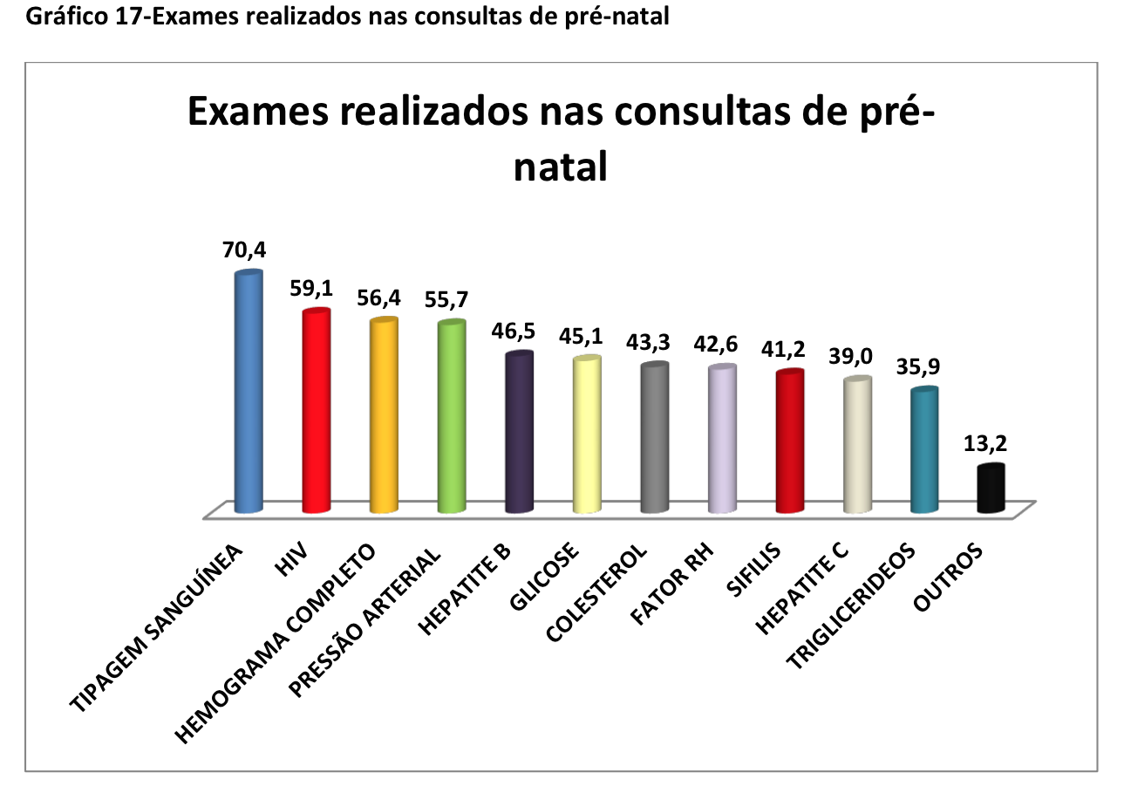
Brazil: 14% of men reached in pre-natal visit are going for follow-up visit

Slide 15


THE POLICIES WE NEED
PAID, NON-TRANSFERABLE, EQUITABLE LEAVE + SUBSIDIZED CHILD CARE
ENGAGE FATHERS IN ECD
USE HEALTH SECTOR AS PORT ENTRY
SCALE UP EFFECTIVE PARENT TRAINING WITH AFFIRMATIVE ACTION TO ENGAGE FATHERS
TEACH BOYS AND GIRLS EARLY
SUPPORT AND RESPECT THE DIVERISTY OF CAREGIVING
@MenCareGlobal #SOWF

Slide 16
